Slide 1


Unit-III
MGN-502
Learning
p. b. Narendra Kiran
Assistant professor

Slide 2

At the end of this lecture, you will be able to-
Importance of Learning
Nature and Principles of Learning
Process of Learning
Theories of Learning

Slide 3
Learning
Learning is the process of acquiring new understanding, knowledge, behaviors, skills, values, attitudes, and preferences.
The ability to learn is possessed by humans, animals, and some machines.

Slide 4
Learning
Learning is “a process that leads to change, which occurs as a result of experience and increases the potential for improved performance and future learning”
The change in the learner may happen at the level of knowledge, attitude or behavior.

Slide 5
A Definition of Learning
Definition of learning
Learning is:
  An experiential process
  Resulting in a relatively permanent change
  Not explained by temporary states, maturation, or innate response tendencies.

Slide 6
Three Limits on the Definition
Three limits on the definition
The change that occurs during learning is a potential for behavior that depends on other conditions.
Learning is not always a permanent change.
  What can be learned can be unlearned.
Changes also occur for other reasons – maturation, motivation.

Slide 7
Learning
Learning includes----
  Knowledge
  Experience
  Change
  Improvement

Slide 8
Nature of Learning
Learning is a process
It involves all those experiences and training of an individual which helps to change his behaviour.
Learning prepares the individual to adjust and adopt in the situations.
All the learning is purposeful and goal oriented
Learning is universal and continuous.
It is a continuous and never ending process that goes from womb to tomb.

Slide 9
How learning is helpful?
Learning helps in attainment of teaching – learning objectives
Learning helps in the proper growth and development
Learning helps in the balanced development of the personality
Learning helps in proper adjustment
Learning helps in the realization of goals of life
Learning does not necessarily imply improvement.

Slide 10
Law of Learning
Law of readiness (Person ready to learn)
Law of effect (Stressful situation)
Law of exercise (practice number of time)
Law of disuse (which is not practiced become decays)
Law of primacy (interested novels)
Law of purpose (work towards goal)
Law of association

Slide 11
5 principles of learning
Participation
Repetition
Relevance
Transference
Feedback

Slide 12
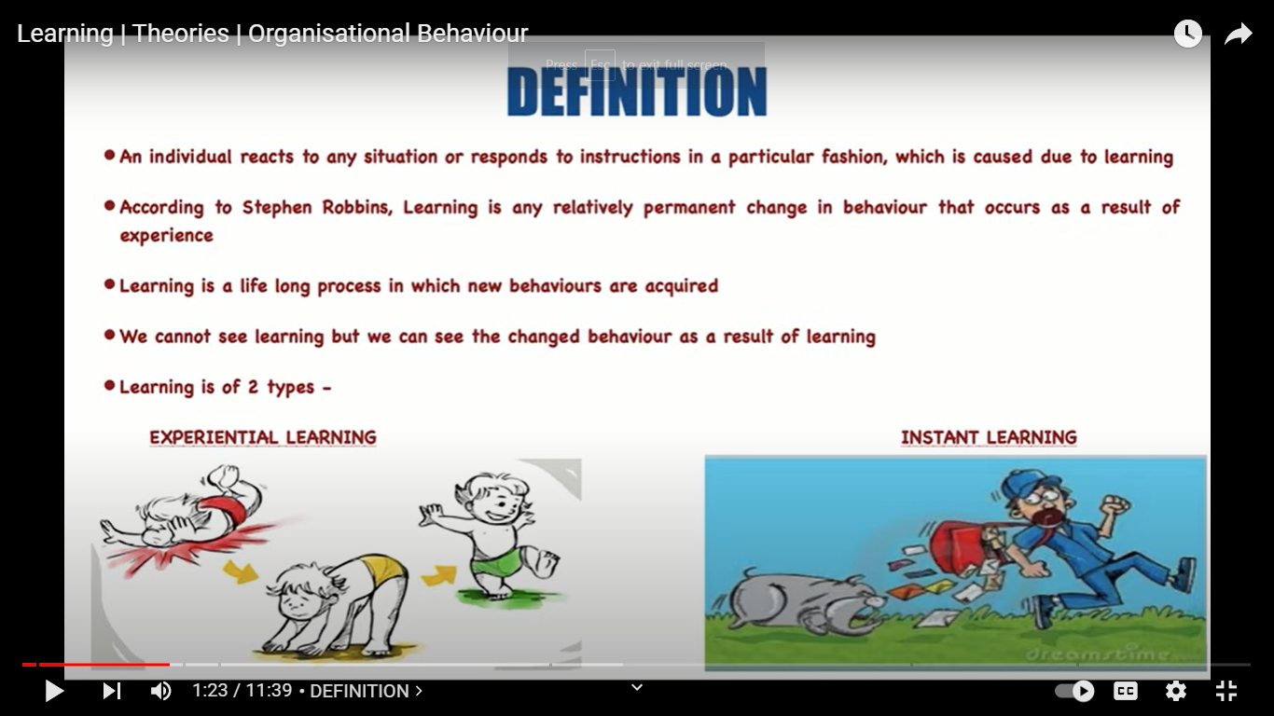
Types of learning

Slide 13
Domains of learning (3 levels of mind)
Cognitive Domain
  Knowledge, comprehension, Application, analysis, synthesis and Evaluation
Affective Domain
  Receiving Phenomena, Responding to phenomena, valuing, organization, characterization.
Psychomotor Domain
  Perception, Set, Guided Response, Mechanism, complex overt response, adaptation, origination.

Slide 14
Learning Theories in Organisational Behaviour

Slide 15
Learning Theories
The most basic purpose of learning theory like any other is to better explain how learning occurs.
Attempts have been made by the psychologists and behavioural scientists to develop theories of learning.
How do we learn? Four theories have been offered to explain the process by which we acquire patterns of behaviour:

Slide 16
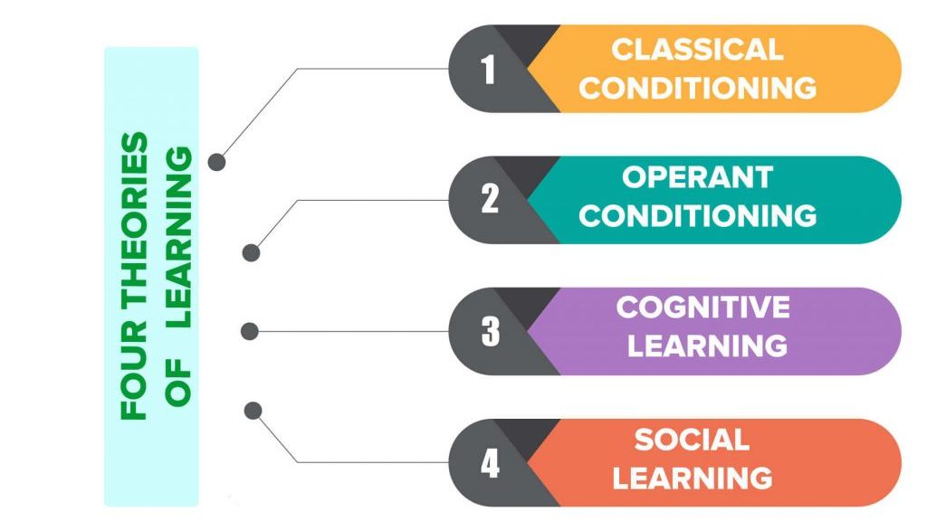
Theories

Slide 17
Classical conditioning theory
Classical conditioning is a behaviorist theory of learning developed by Ivon Pavlov (Russian Psychologist).
It posits that when a naturally occurring stimulus and an environmental stimulus are repeatedly paired, the environmental stimulus will eventually elicit a similar response to the natural stimulus.

Slide 18
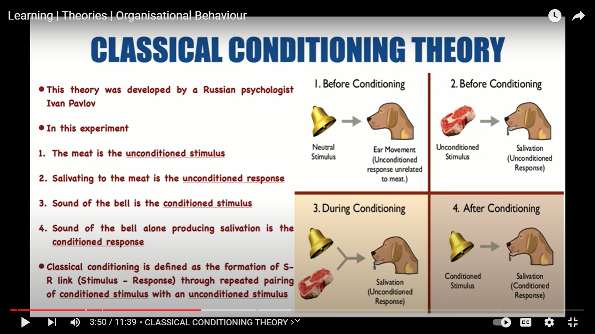
Classical conditioning theory

Slide 19
Operant conditioning theory
Operant conditioning is a type of associative learning process through which the strength of a behavior is modified by reinforcement or punishment.
It is also a procedure that is used to bring about such learning

Slide 20
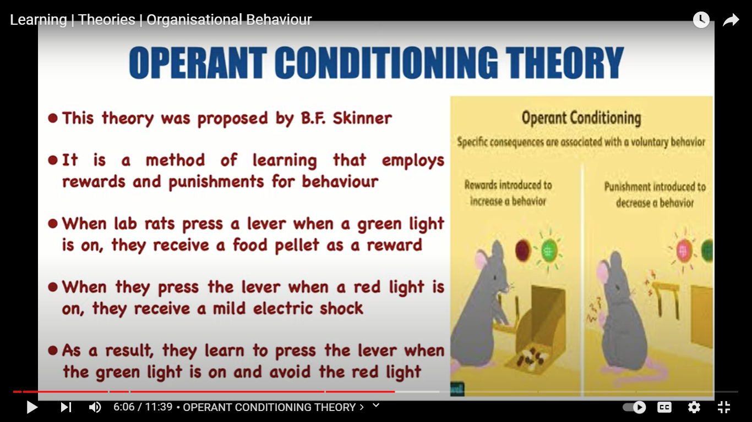
Operant conditioning theory

Slide 21
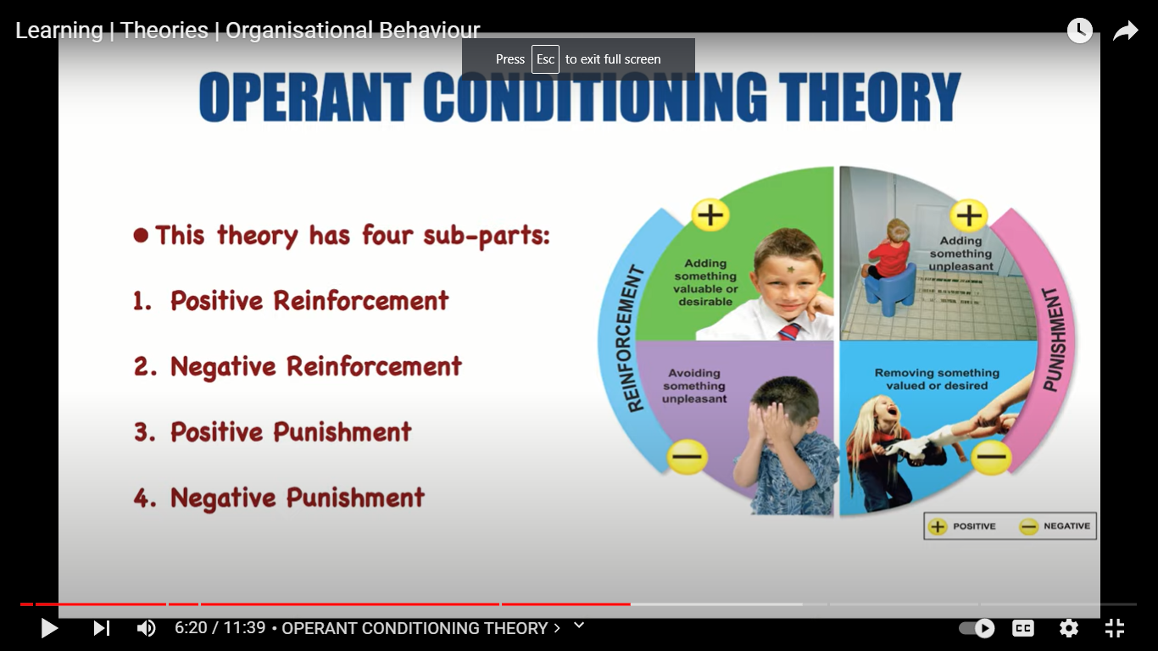
Operant conditioning theory

Slide 22
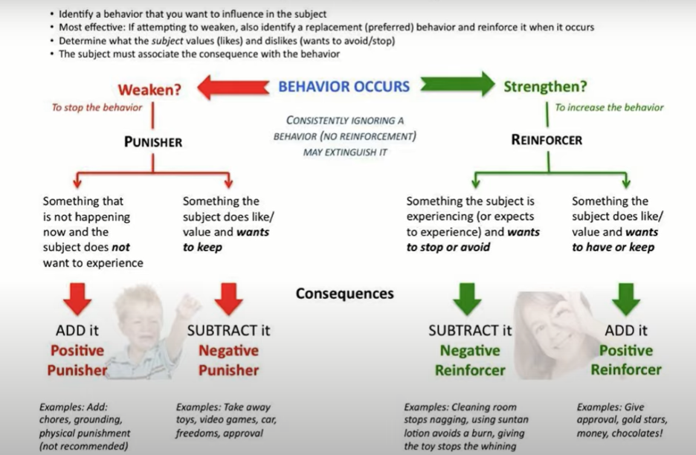
Operant conditioning

Slide 23
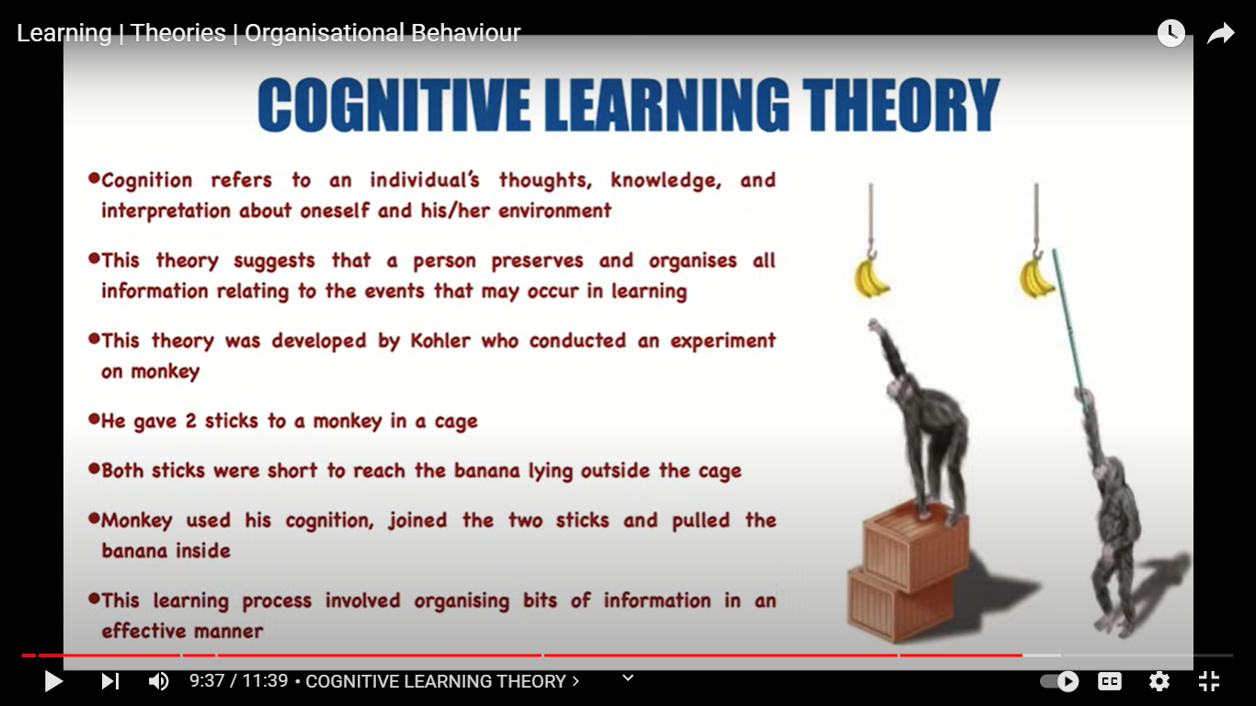
Cognitive Learning theory

Slide 24
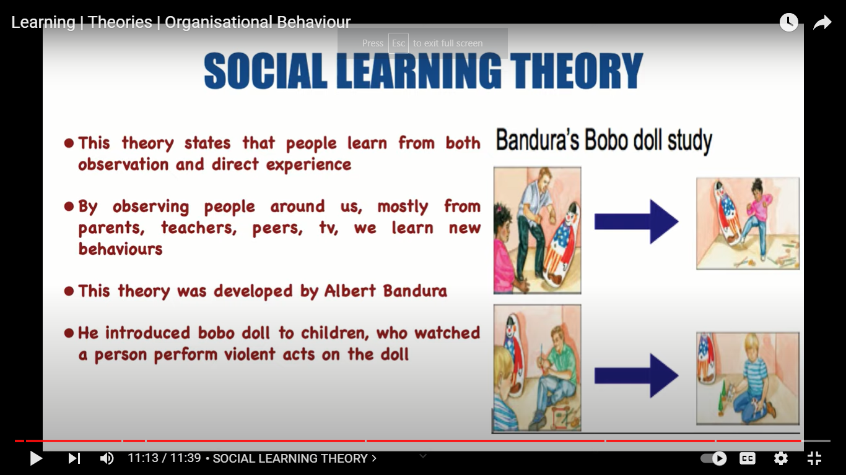
Social Learning theory

Slide 25
THANK YOU

